Slide 1

Planning today for a crisis tomorrow
How to set yourself & your team up for success

Slide 2
What we’ll
Cover
Anticipating the worst
Plans, policies & procedures
Training integration
First-hour checklist
First-hour holding statements
Q&A
Notes:
The best time to plan for a crisis is BEFORE it happens
In this workshop, we’ll talk about how to plan, how to train, and what to do in the first hour after a crisis.
At the end of this session, you’ll be able to:
Research and identify the common types of crises your agency could face
Discuss the plans, policies and procedures that shape your agency’s crisis communication response
Identify ways to integrate your communications and PIO team into training exercises
List the steps you and your communications team should take in the first hour after a crisis
Discuss effective first-hour holding statements and multimedia content
We’ve only got an hour so it might seem like a lot to cover but never fear:
I’ve put together a lot of one pagers and handouts that you can refer back to after we’re done here.
And you can reach out to me at any time.
So let’s get started.

Slide 3

There’s been a natural disaster…
Notes:
First things first: Let’s hear from you
There’s been a natural disaster in your area. How confident are you that you know what to do first?
Not confident at all
Slightly confident
Somewhat confident
Fairly confident
Completely confident
Not sure
That’s OK! That’s why we’re all here. The goal is to move you up one notch on the confidence scale by the time we leave this Zoom.

Slide 4
Anticipating the worst
Risk
What might go wrong
Crisis
What is going wrong
Notes:
The difference between RISK and CRISIS is fairly simple: Risk is what MIGHT go wrong. Crisis is what IS going wrong. One is future, one is present.
We can’t predict the future, but we usually can anticipate the risks most likely to occur in our communities.
Why does that matter? Because we can put mitigation strategies in place before they happen.
Mitigation is just as important for communication as it is for flooding or wildfire or any other emergency.
Sources:
Dr. Peter M. Sandman Crisis Communication (n.d.) Crisis Communication (High Hazard, High Outrage). https://www.psandman.com/index-CC.htm

Slide 5
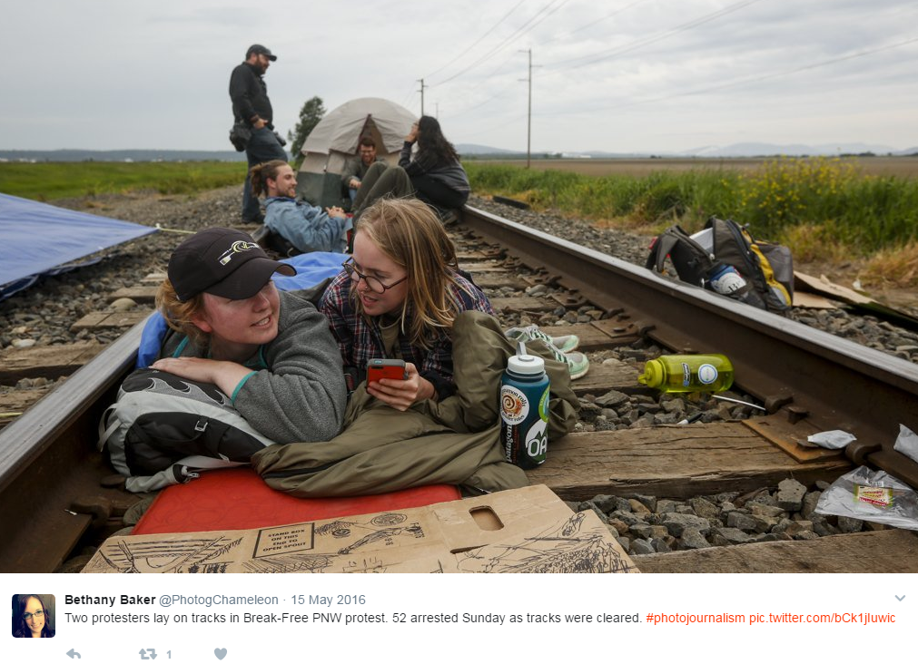
What’s likely to go wrong?
You know your community
  Natural hazards
  Man-made hazards
Historic events
Vulnerabilities
  Who could be impacted?
Notes:
So: What’s likely to go wrong? It could be anything.
Like this photo here. It’s from the 2016 Break Free protest that shut down this rail line and two local oil refineries. We planned ahead for the protest – because the protesters announced their intentions far enough in advance that we set up an EOC and a JIC. We’d even planned what to say during the inevitable arrests. What didn’t we plan for?
The garbage scandal. Yep. When the protesters were arrested, booked, and released ~48 hours later, any personal items they left near the scene had been collected and taken to the county’s dump.
They were outraged and THAT made the news. Not the protest itself. What we did with their belongings.
I tell you that to tell you this:
YOU are (probably) the expert on what could go wrong in your community. Really! You don’t need me to help you identify the risks.
YOU know the climate, and major businesses or industries, and the annual events in your area.
For example, I live on an island in Washington state.
I know I’m at risk for: Tsunami, earthquakes, coastal flooding, windstorms, and possibly volcanic eruptions – those are natural hazards.
I’m also at risk for a refinery fire or explosion, or a military plane crash because I’m one island over from a naval air station – those are called man-made hazards.
Natural or manmade hazards can affect any of our communities at any time.
Sometimes we get advance warning: Think NWS alerts for tornado, hurricane, flood forecasts – red flag warnings, etc. Sometimes we don’t.
Another way we can figure out what might go wrong is to look back at historic events.in our area.
For Washington, a recent historic event that could happen again (not soon, we hope) was the 1980 eruption of Mount Saint Helens.
Historic events give us perspective on what HAS happened and what COULD happen again.
Now let’s think about vulnerabilities. Not just WHAT the risk is but WHO is at risk.
Who could be impacted by the hazards in your area and how bad could it be?
Infrastructure like roads and power grids
Hospitals and businesses
Vulnerable populations
The list goes on…
To sum up: The first step in making or updating a crisis plan plan is to figure out what could go wrong – in detail.
Source:
Unit 3: Threat/Hazard Assessment. FEMA. Retrieved April 19, 2022, from https://www.fema.gov/pdf/plan/prevent/rms/155/e155_unit_iii.pdf
Unit 13: Hazards Risk Management. FEMA. Scope Community Vulnerability. Retrieved April 19, 2022, from https://training.fema.gov/hiedu/docs/hazriskmanage/hazards%20risk%20mtmt%20-%20session%2013%20-%20scope%20community%20vulnerability.doc

Slide 6
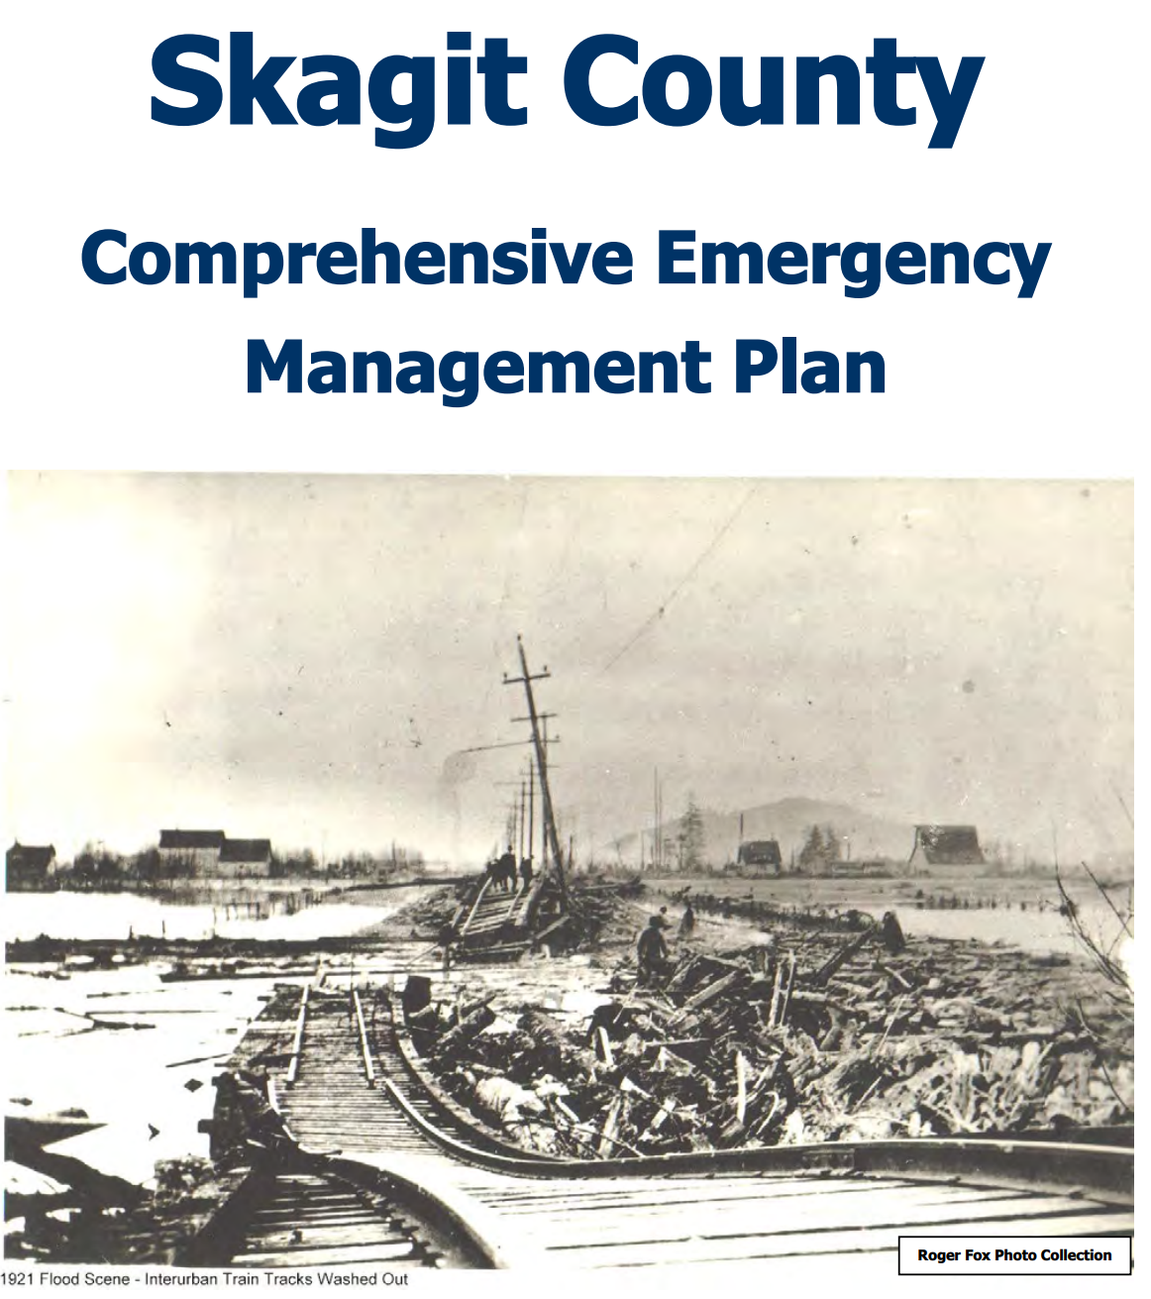
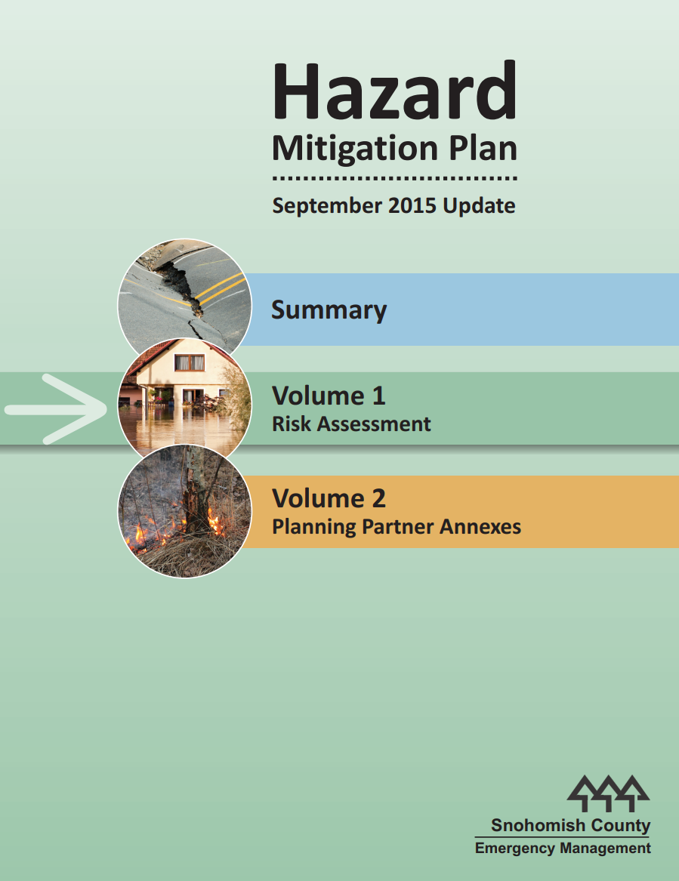
Research may already exist!
THIRA - Threat and Hazard Identification and Risk Assessment
HVA - Hazard Vulnerability Analysis/Assessment
CEMP - Comprehensive Emergency Management Plan
NHMP – Natural Hazard Mitigation Plan
COOP – Continuity of Operations Plan
Notes:
The responsibility for thinking about all the things that could go wrong is NOT ENTIRELY ON YOU!
In many cases, the research you need has already been done by someone else.
How many of you know your emergency management colleagues?
If you don’t, add that to your to-do list for the next quarter. You’ll want to know these folks before an emergency – and they might be able to help you with your emergency communication planning.
Their job is to create plans that (among other things) identify risks and mitigation measures. You can look for:
THIRA – Threat and Hazard Identification and Risk Assessment
HVA – Hazard Vulnerability Analysis or Assessment
CEMP – Comprehensive Emergency Management Plans
NHMP – Natural Hazard Mitigation Plan
COOP – Continuity of Operations Plan
You don’t have to be an emergency manager to get value from these plans. Essentially, some of that “what could go wrong” work has been done for you.
These plans should identify common hazards/threats/risks and the mitigation or preparedness measures the agency has in place to address them.
You can review these plans and use the information to refine your list of potential risks AND your emergency messaging plans .
For example, these plans may tell you about designated shelter locations or evacuation routes.
That information helps you communicate better in a crisis.
Rather than saying “Evacuate your home and go to the nearest shelter,” you can say “Residents of LOCATION can evacuate to SPECIFIC SHELTER.”
You can even create custom Google Maps with evacuation routes or shelter locations, etc and have those maps ready to use in a crisis.
Resources:
https://www.ready.gov/risk-assessment

Slide 7
Communications plans
What plans do you have?
What do they say?
Who is impacted by them?
How are they implemented?
Notes:
Does your agency have an EMERGENCY communications plan? An ESF-15 plan? (That’s FEMA-speak for Emergency Support Function 15 – External Affairs aka PIO/JIS/JIC)
If you do: Great! If not, your colleagues and/or FEMA may have sample plans you can use to create a framework for communications response.
Many of you may already be familiar with crisis communications planning, so this won’t be a deep dive into what should be in your Crisis Comms plan. But we are going to talk about some key questions you should ask about that plan.
For those of you who are new to emergencies, at basic level, your emergency communications plan should outline HOW your agency expects to communicate during an emergency.
It should include specific roles and responsibilities, organizational charts, guidelines for how to conduct the initial communications response, recommendations for media briefings, etc.
Plans may be agencywide or specific to one department.
For example: At my last agency, the public works department had a crisis communication plan. I was the communications director. I didn’t work in the public works department, but their plan specifically called out my position as one that would lead the communications efforts for their department. Had I not asked about the plan, I wouldn’t have known (1) that it existed and (2) that I had some role in it.
When you leave this webinar, there are a few questions you should ask about your crisis communication plan:
At a bare minimum here’s what you should know:
What Communications plans does your agency have?
Is there an emergency or crisis communications plan?
What department owns or updates those plans?
What do each of the plans say about communication during an emergency?
Are there specific responsibilities for you or your department/division? Do you need to put out specific emergency messaging?
Who is impacted by your plans?
Do these plans call on you, your staff, or your department/division to fill a specific emergency communications function?
How are these plans implemented?
Who notifies you of an emergency? When do you start using the plan?

Slide 8
What to include
(if it’s not already there)
Roles & responsibilities
Access
Records retention
Approval process
Notes:
Once you know what your communication plan says, here are a few things you’ll want to consider adding (or updating, or including for the first time if you need to write a crisis comms plan for your agency):
Roles and Responsibilities: Be very specific about what roles communications positions will fill in an emergency and what their job duties will be.
Focus on positions vs. individuals. The Communications Director vs. Jane Smith.
Be specific about what authority each position has (do they supervise others?)
Access: Clarify who can and should access specific social media accounts and webpages
What JIC positions OR Agency positions have access to social media, websites, reverse 911, or WEA?
Which social media account(s) and/or webpages should your agency primarily use during an emergency?
Records retention: How are you tracking and retaining content posted to social media?
What social media archiving do you have in place?
If it’s an archiving service, is it connected to the accounts you’re using in an emergency?
Approval process: Who has the final authority for verifying and approving messaging?
Does your communications plan clearly explain what the messaging approval processes are?
Are any messages preapproved (like holding statements)?

Slide 9
Have you been the lead pio in an emergency?
Notes:
Now I have a question for you:
Have you ever been the lead PIO or primary spokesperson during an emergency? Either a real one or a simulated one in training
Yes during a real-world emergency
Yes during a training exercise
No, but I’ve had other emergency communications roles
No, I haven’t had any emergency communications experience
We learn something new in every situation where we fill an emergency communications role. In the chat, share one thing you learned during your most recent real-world incident or training scenario. (OPTIONAL BASED ON TIME)

Slide 10
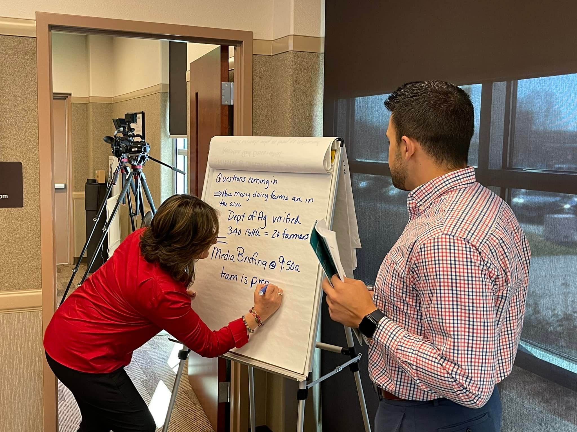
But first,
We train
Individual training
  FEMA
  Argonne National Laboratory
  National Disaster Preparedness Training Center
Agency training
  Tabletop exercise
  Drill or full-scale exercise
Notes:
You wouldn’t run a 10K without training, would you?
Ok, maybe you would. But how do you think you’d feel afterward? A little sore, a little reflective – maybe you learned that you CAN do it, but if you did it again, you’d try a different tactic?
Emergency communication is no different. You’re communications professionals and that means you’ve got the skills you need to succeed.
However … we never know how we’ll react under pressure, what we might forget, who we might need to call for support, etc.
That’s why emergency communications training – regular training – is crucial. It builds your emergency communications muscle memory.
You can – and I highly recommend – take individual social media and crisis communications training through FEMA, ANL and NDPTC.
You’re probably familiar with FEMA. Argonne is actually a government agency that works with the Federal Department of Energy (think nuclear things)
NDPTC is part of the National Domestic Preparedness Consortium.
In addition to training classes, you can also work with your Emergency Management partners (or first responders) to integrate your communications team into existing trainings.
I’ll break it down for you on the next slide, but generally speaking, your agency trains on an annual basis.
It may be a tabletop exercise, where you sit around a table and talk through/virtually walk through how you’d respond to a scenario.
It may be a drill (where you test one aspect of an emergency plan, like marine rescue), or a full-scale exercise (where you test an entire plan based on a specific scenario).
Unfortunately, most first-responder agencies or emergency management divisions don’t advertise these trainings nor do they give the communications department a heads up about them.
SO ASK!
“Hey [insert name of department director here]. It’s important that my communications team knows how to support you/our agency in an emergency. What trainings do you have scheduled this year/quarter?”
Get the conversation started and ….
Image credit:
Argonne National Laboratory PAST Fusion Cell Facebook page; April 6, 2022 https://www.facebook.com/photo?fbid=302539821987746&set=pcb.302539885321073

Slide 11
Ask to be a part of training
Existing agency training
01
Partner agency training
02
State or regional exercise
03
I’ll just do it myself, thanks
04
Notes:
…ASK TO BE A PART OF THE TRAINING
Many of you may already be doing one or all of these steps. If you’re not, here are some strategies to consider … especially if you get pushback.
The most common pushback you’ll get is “We’ve already planned out the exercise and we can’t add a new player/department”
You may also hear “Communications doesn’t need to be there.”
A previous agency I worked for set up a full-scale active shooter drill at the local college … less than 6 months after an ACTUAL active shooter incident in our town. They told me communications didn’t need to be there – for the drill or to alert the public/media about what would be going on at the college.
What could go wrong?
Long story short: I had a *delicate* conversation with the Emergency Management division and next thing you know, I did some public outreach and the college used the drill to test out their JIS/JIC plan.
My point? Advocate for yourself and your department, no matter what you’re told when you ask to participate.
Remember: Communications SHOULD ALWAYS HAVE A SEAT AT THE TABLE. In an emergency, PIO is part of the command staff in nearly every JIC org chart. That means your job deserves just as much respect as the person running the incident.
You don’t need the Emergency Manager or Sheriff (or whomever) to do much extra work, even if the exercise is fully planned. You just need to explain how you’ll fit in AND how little extra work the EM/Sheriff/etc. will actually have to do.
The easier you make it on them, the more likely they are to say yes.
Once you have a relationship with your emergency manager, here are a few ideas for how to integrate yourself and your department into existing trainings.
Find out what training your agency does each year. (Spoiler alert: Someone is ALWAYS doing training – you just have to ask around and find the schedule)
For example, each year, I know the Fire Department I work for conducts rope rescue training. I could talk with the Fire Chief and ask if they would allow me and my communications team to be on site for the training. We could use their activities and conversations as the scenario for which we could craft social media content, website posts, take photos/video, and plan our communications strategy as if it were an actual emergency.
Ask if you can be included. You don’t have to be an active player but you do need:
Access to the exercise facilitators so that you have information
Access to any scenarios created for the exercise
Identify what part of your communications plan you want to test
For example, you may want to test internal communication, so you could use their scenario and information from the field to have your team draft sample messages and identify how (and to whom) the messages would be disseminated.
Find out what training your partner agencies do each year. Think about your local cities/towns, counties or municipalities, colleges or universities, etc. Your agency EM may know about partner agency trainings. Ask them!
Ask if you can be included OR if that agency’s communications department is already participating.
Repeat the same steps from option 1: Get permission, get access to information, identify what part of your plan you want to test.
Find out if your region (county, regional response group, etc.) is doing training or an exercise. Check with your state office of emergency management, too
Ask if you can be included OR if that agency’s communications department is already participating.
Repeat the same steps from option 1: Get permission, get access to information, identify what part of your plan you want to test.
If all else fails: Do it yourself.
Realistically, you don’t need to be part of an exercise to test your communications plans and test yourself and your staff to see where you excel and where you can improve.
You just need a scenario, some injects (updates to the situation), an idea of who you want to train, and what part of your plan you want to train.
It doesn’t need to be complicated. You can do it sitting around a table talking through how you’d notify someone of an emergency, what they’d do, how they’d respond
Or it can be a timed exercise where staff craft messages in response to a scenario, practice calling or emailing information to each other, asking for information verification, preparing a press briefing… the possibilities are endless

Slide 12
Checklists
& holding statements
Notes:
These are all Word templates with fillable sections so you can customize it to meet the needs of your department and/or agency.

Slide 13
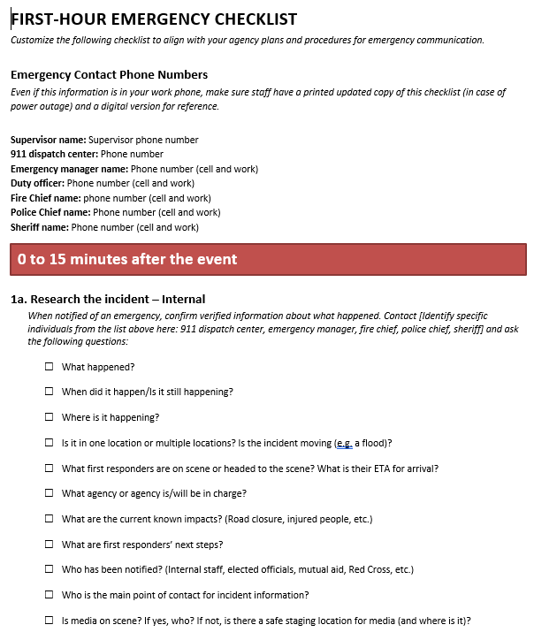
First-hour checklist
Who to contact
What to ask
When to report up
Where to research
Where to post information
Where and how to listen
Notes:
The first hour of any emergency is stressful – even if you’ve done it a thousand times.
It helps to have a checklist of what to do and in what order:
Who would you contact first?
What would be the first thing you ask?
Who would you call first – internally and externally?
Where would you look for information first?
Where’s the first place you’d post information?
A checklist means you don’t have to remember everything, everyone else knows exactly what’s being done, you can delegate tasks if needed, then check off what’s been accomplished
You can adapt this checklist to match your crisis plans and I recommend updating it at least once per year
If you’ve done a training or had a real event, use information from your hotwash or after-action review to assess and update this checklist.

Slide 14
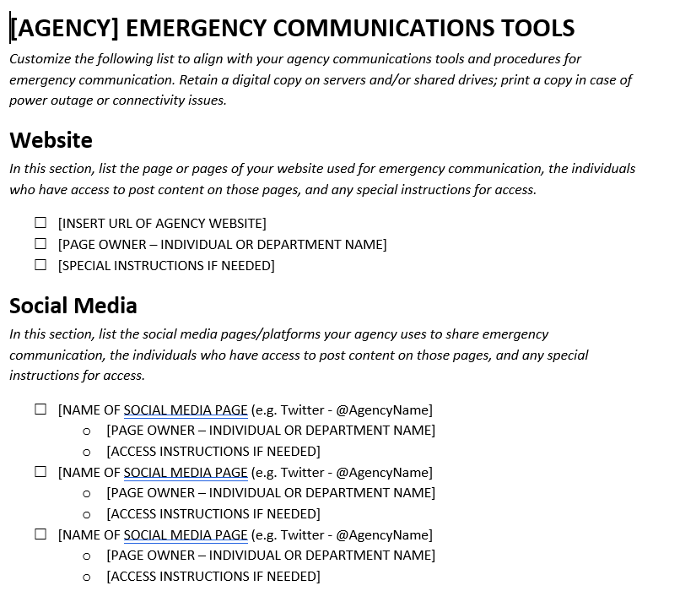
What’s in your toolkit
What communications tools do you use in an emergency?
Who has access to them?
Where are your plans saved?
Notes:
Not only do you need to think about WHAT you’ll do in that first hour, you need to consider HOW and WHERE you’ll do it
Do you use specific methods to share emergency info? For example, Alert Sense or CodeRed.
What about social media?
What’s the primary social account you use?
Who has access to post to social media? The web?
Before a crisis happens, think through all the tools you use to communicate with internal and external stakeholders.
Talk with your emergency management partners to see what tools they use – and if they’re different from yours. You don’t want to duplicate effort, but you also don’t want to forget to share content on a channel people go to for emergency information.
Make sure you know who has access to each tool.
What happens if the administrator for your Facebook page is on vacation when a crisis happens? Who else has access or might need access?
Filling out this toolkit means you have something to reference in an emergency. Hopefully you won’t panic – you’ll be able to say (for example) “Oh, we need to contact Public Works and ask them to add us as an administrator to Facebook so we can use that account during hurricane season.”
This customizable list can be included in your communications plan (if it’s not already) and should be updated as staff or communications tools change.

Slide 15
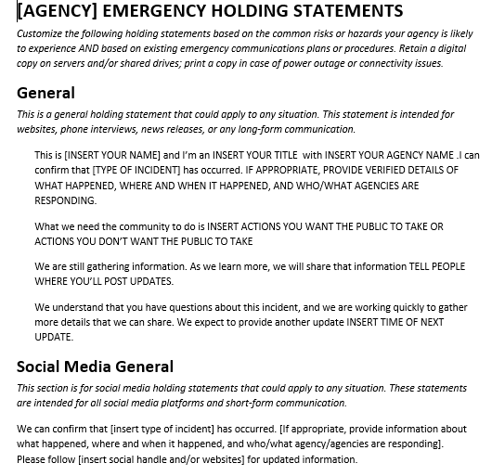
Holding statements
What you say when you really don’t know anything
Anticipate risks, draft fill-in-the-blank messaging
Saves you time & sanity
Notes:
What do you say when you don’t know much?
Something like “Camano Island Fire & Rescue can confirm that the abandoned sailboat at Barnum Point is on fire and firefighters are responding. As get more information, we’ll post it here and on our website, www.camanofire.com”
That’s a holding statement.
Many of you may already have holding statements – you may have already written them, anticipating an emergency, or you might have them but not know it.
What do I mean? Well, we talked about historical risks earlier. Have you written a news release about a regular weather event in your area? Shared social media posts?
What you’ve written during past emergencies may be a great starting point for a holding statement.
If you’re not familiar with holding statements, they’re fill-in-the-blank-style statements that tell your audience what you DO know (even if what you know isn’t much).
They help fill the information vacuum in an emergency. People want to know what’s going on – and your holding statement(s) can meet that need.
Based on what you already know about risks in your area, you can adapt and customize these statements (for example, by adding location of predetermined emergency shelters or evacuation routes).
These statements can be preapproved by whoever at your agency (based on your crisis plans) has the authority to approve them, then used in the first hour of a crisis.
Naturally you’ll still want to follow your agency’s emergency information approval processes, but having these prewritten and cued up will save you time and a little bit of sanity.

Slide 16
Got questions?
Now’s the time to ask

Slide 17



bronlea@bronleamconsulting.com
Bronlea M Consulting
www.bronleamconsulting.com
Notes:
Please feel free to reach out if you have questions or would like to request a custom crisis communications training for your agency.

